Slide 1
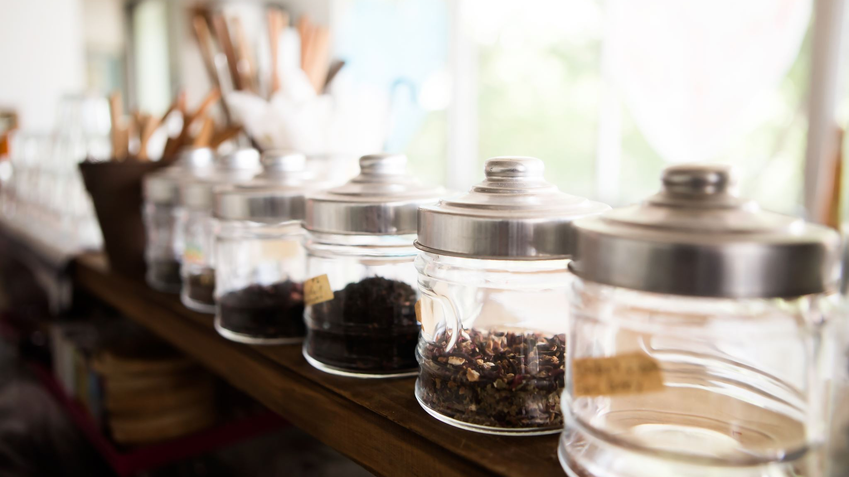
Kitchen Layout and Arrangement
A U A D Case S t u d y - Deepa Varghese

Slide 2
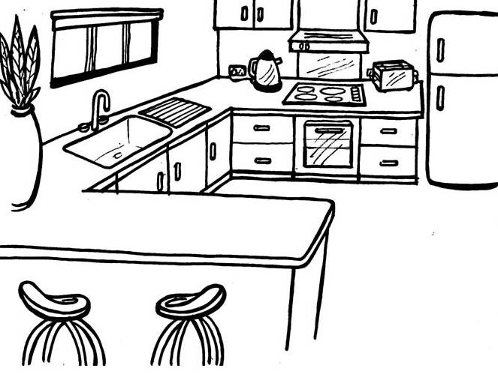
Design Category Selection: HOME KITCHEN -> where the members of a home prepare meals. Focused Area: KITCHEN LAYOUT/ARRANGEMENT -> Bird’s eye view of what a kitchen should look like.

Slide 3
Contextual Research
Kitchen Ergonomics
UX Case Studies with Design Solutions for “Smart Kitchens” (Screens, Projectors, Audio/Video devices)
UX Case Studies on principles for arranging a Kitchen
Virtual Systems for Designing Kitchens using Kansei Engineering
Virtual Reality/Augmented Reality setups to allow customers to design their kitchens
Web-based tools for allowing customers to design their kitchens

Slide 4
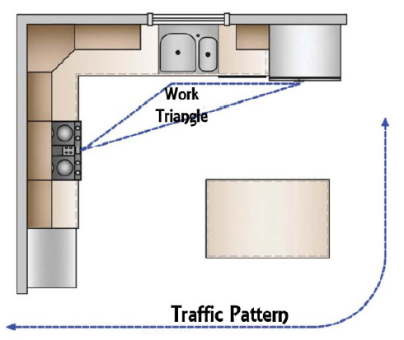
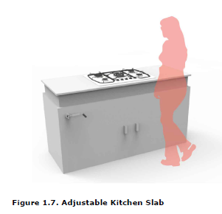
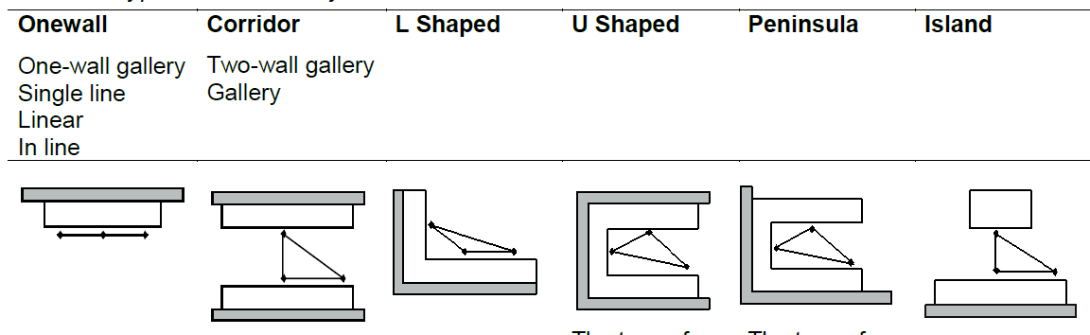
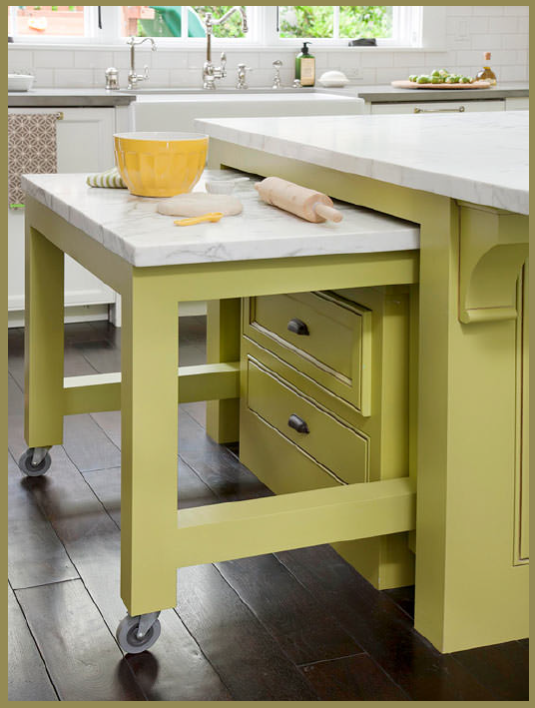
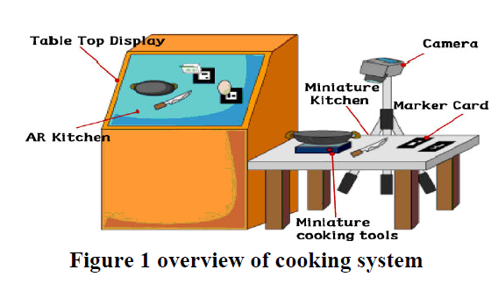
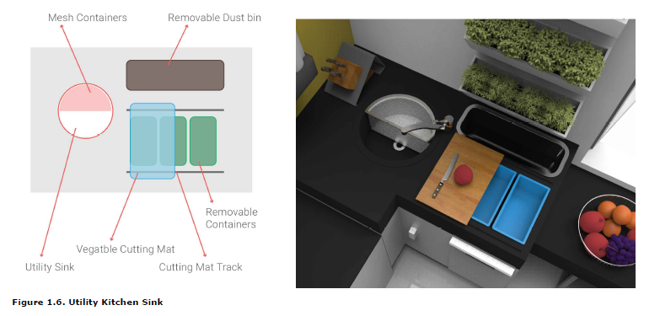
Ideas for custom Platform Heights
Typical Kitchen Layouts
AR system for Kitchen Design
Typical Work Triangle (Sink, Fridge, Stove)
Arranging Kitchen based on Design Principles “Things used together should be close to each other”
Accessibility
Notes:
There is enough research done on Kitchen Ergonomics, and yet we don’t have the ideal kitchen. It’s because the height and width of kitchen platforms and cupboard shelves, and fridge etc. are still created based on the “average”d heights of an entire population. One research pointed out how the kitchen design in India still follows the old ergonomic rules that were created with research done on European women who generally tend be taller. “Ageing in place” is also another issue raised by a couple of researches done, which show that the kitchen cannot adapt to the growing needs of it’s aging population. More often than not leading to less than ideal environments. Eventhough much has been done for Accessibility, there are still needs that are specific to a person that are not fully realized There have been efforts made to help people design their own kitchen via a “Virtual Reality” or “Augmented Reality” or “web-based tool” : but all of these either assume that the customer is tech-savy, or can afford to engage in their tool set, where the final design is still in the hands of the Designer, who takes it away to a design lab separate from their reality to return with a finalized design.
In short, no matter how good the research, it still provides solutions for the averaged out specification of multiple users which does not work for even one of them.

Slide 5

User Research
Interviews + Observations = Field Notes

Slide 6
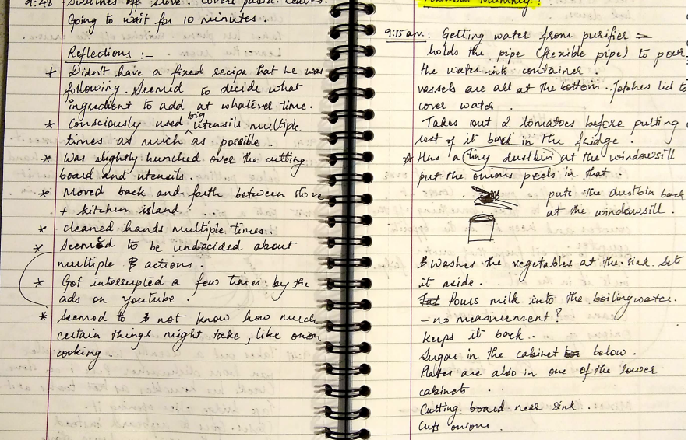
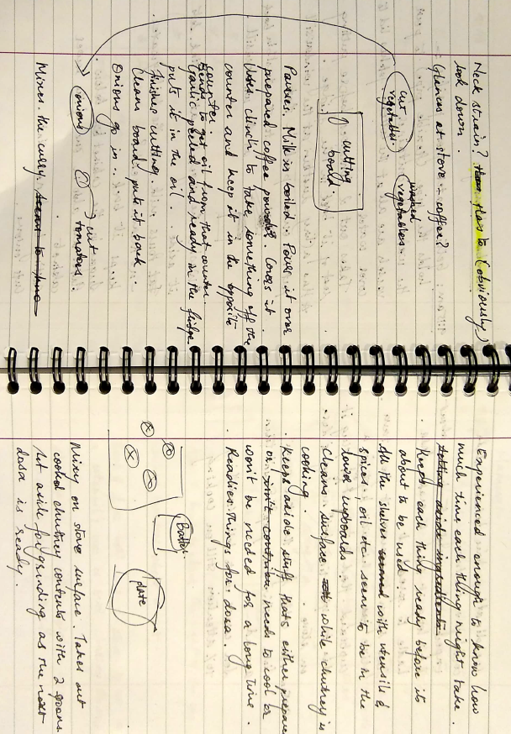
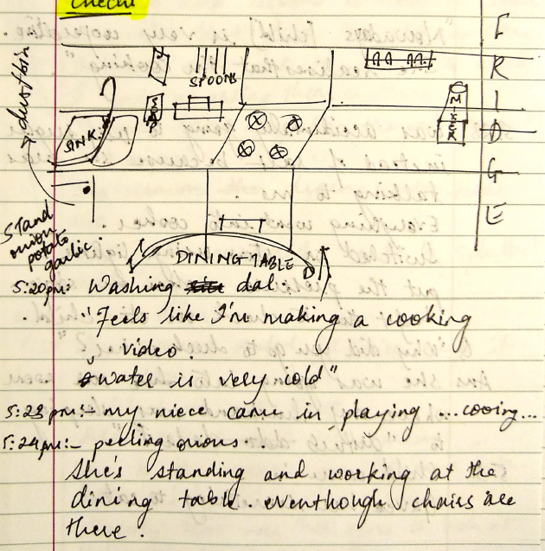
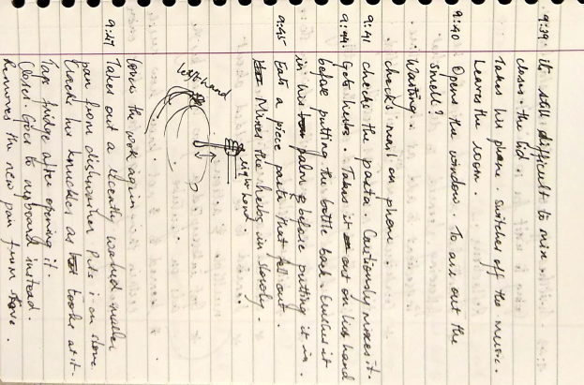
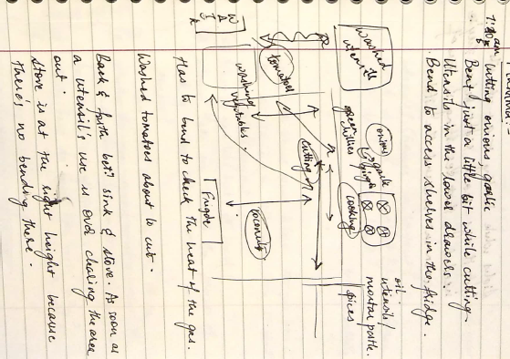
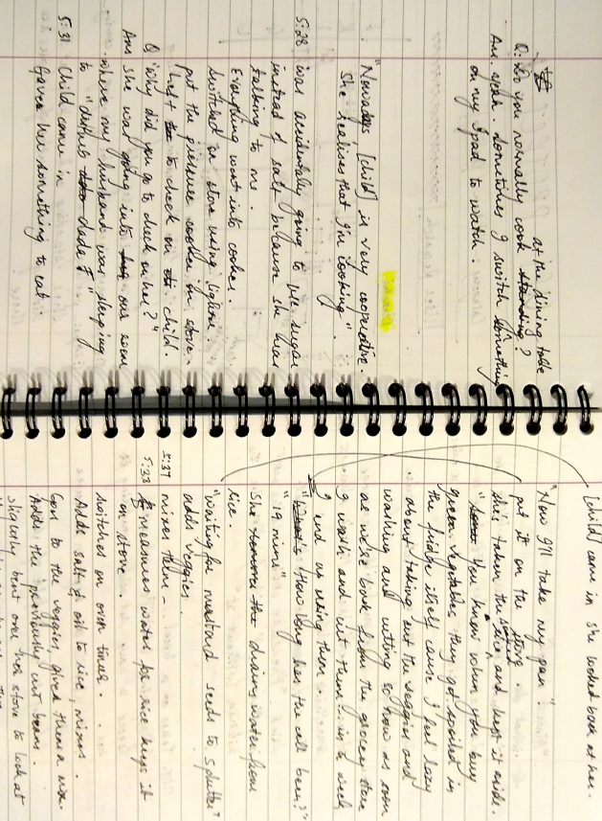
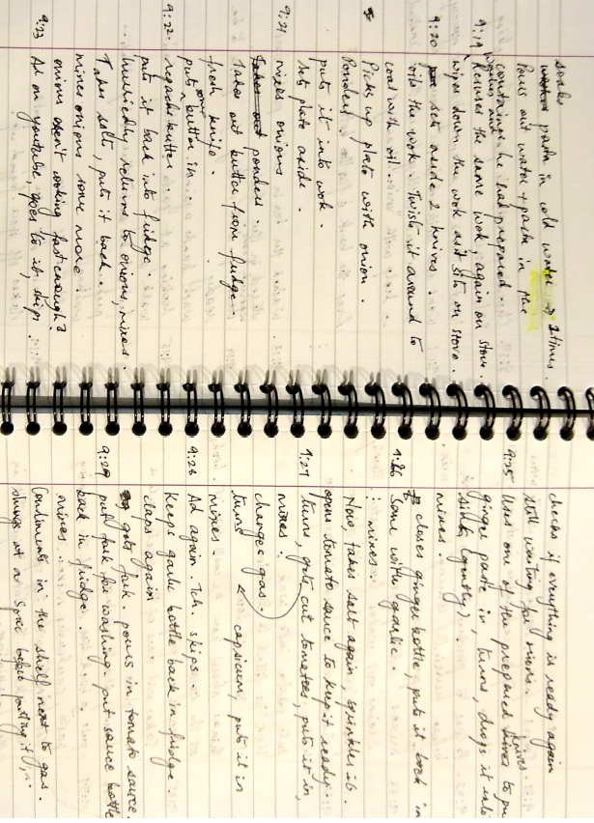
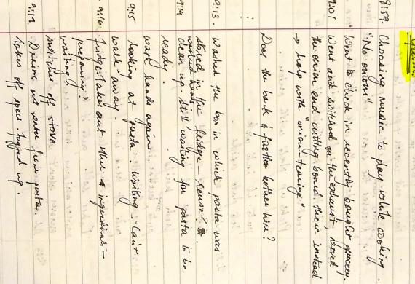
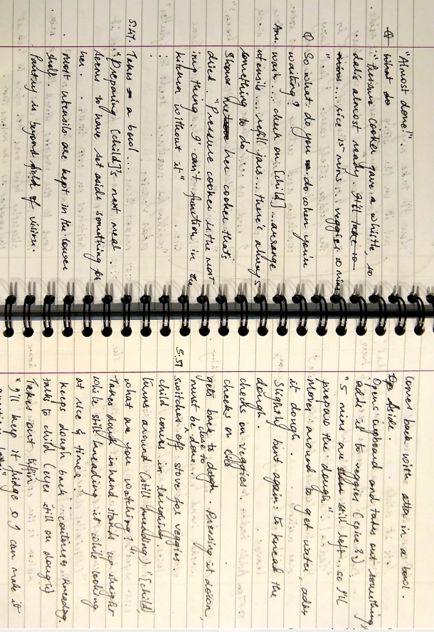
Observations - 4
My Illegible Notes

Slide 7
My Legible Notes
There’s some type of Bending involved for everything, storing below work surface level, storage shelves depth etc.
Platforms are never at the ideal height. Bending neck, upper back is common
Children may demand attention anytime
For Experienced cooks, Multi-tasking (with multiple menu items being cooked simultaneously) is common, resulting in more than the “3” points of a “work triangle” -> quadrilateral? Pentagon? Maybe just a line?
Kitchen can be the epicenter of the family
Kitchen needs to accommodate not just the primary cook, but the secondary cook and ALL other members of the family – and should be customized to accommodate all
2/4 participants used music/videos (recipe?) in the background, and cannot skip ads on Youtube (tch! Tch!)
People tend to find unique ways to accommodate themselves with their kitchen (portable dustbins, hooks on shelves, lazy-susans, spice drawers etc.)

Slide 8
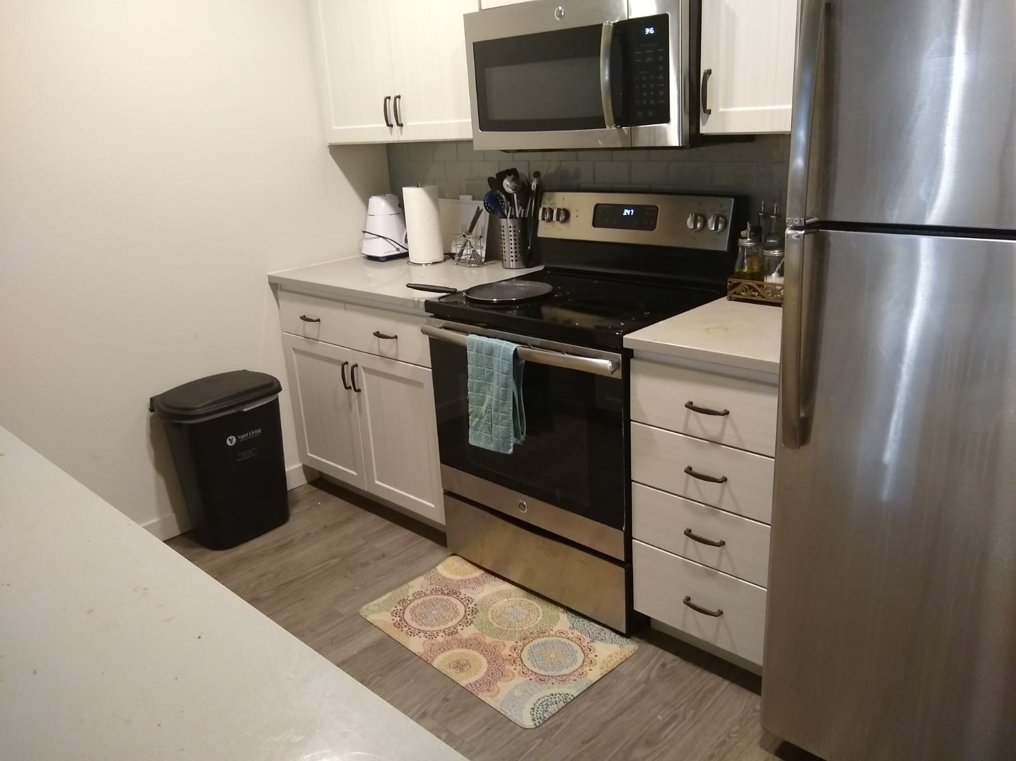
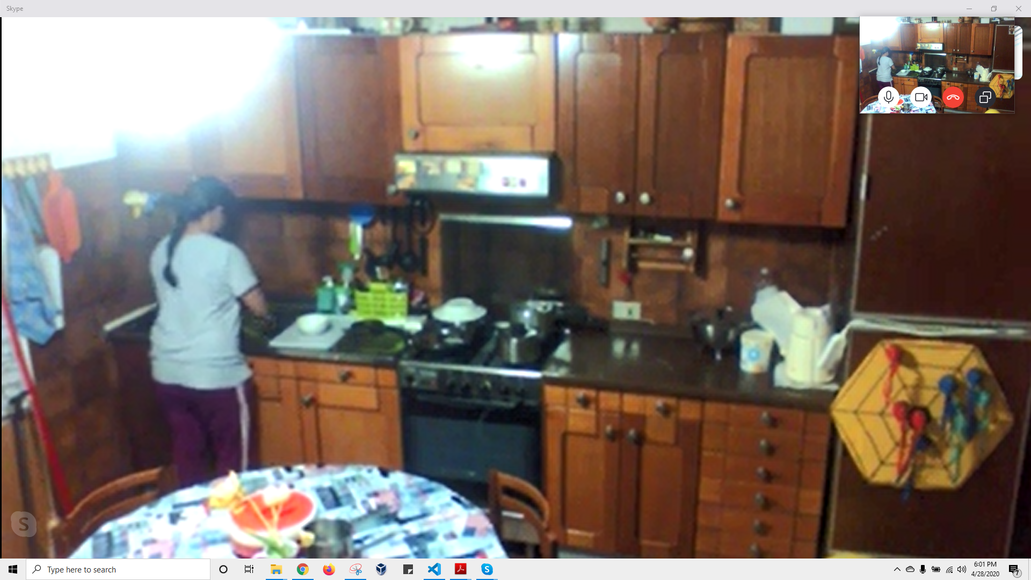
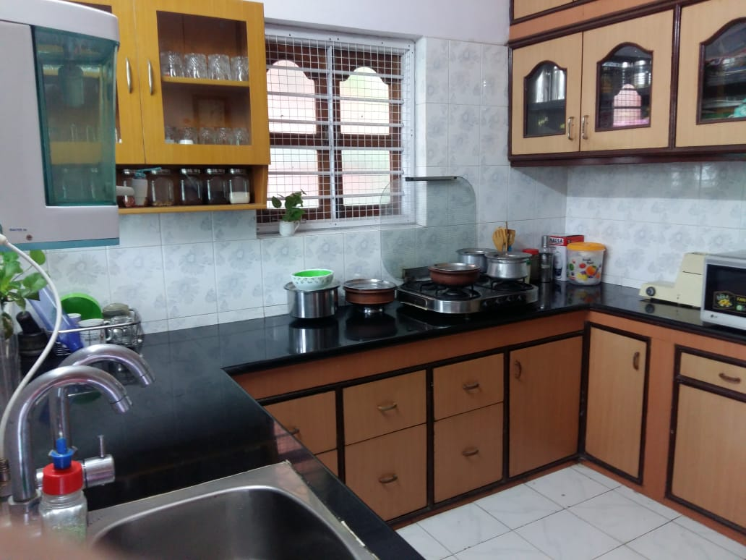

Slide 9
Interviews – 3
Likes
Dislikes
Wishes
Ideas
Vision for the future

Slide 10
Items that afford Auditory/Visual feedback are helpful, because they can be left on their own
Cutting vegetables / Prepping is one of the least favourite activities across the board, because it requires undivided attention, is time consuming, and requires you to stand for long periods at an uncomfortable platform height
Young Mothers need space to accommodate the play area of their children to watch over them
Experienced cooks multi-task (plan ahead or routine)
Need to reach/bend for deep cupboards and dishwasher
Design may be influenced by traditional systems of architecture such as feng-shui, vastu-shastra etc.
People like to decorate (fake/real plants, pictures, posters etc.)
Storage space that is out of reach is wasted.

Slide 11
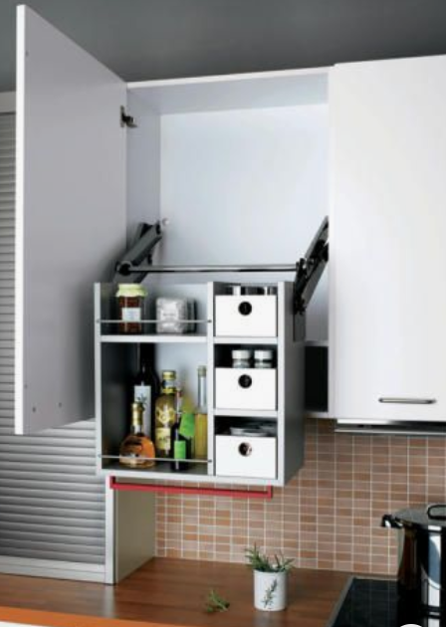
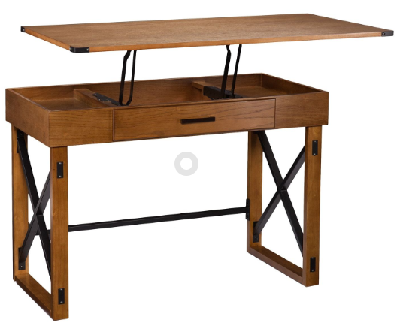
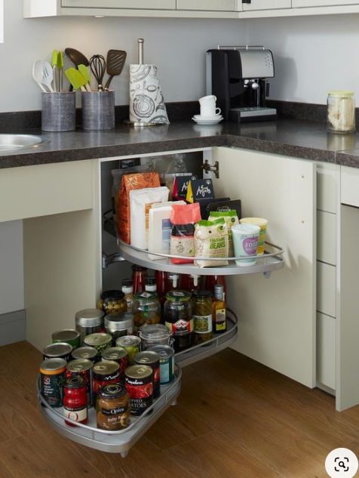
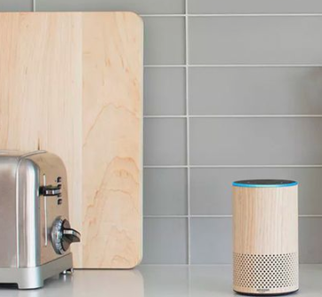
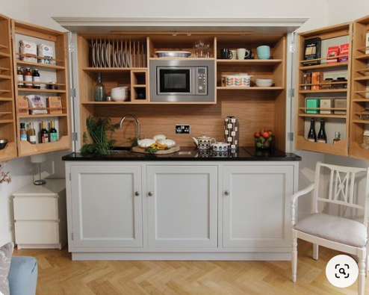
Ideas that came up!
Adjustable Height Kitchen tables!
Drawers that Pop Out!
Alexa for the Kitchen!
Store more in less space!
Turntable pop outs for corner!

Slide 12

Definition
Diagramming + Personas + Problem Statement

Slide 13
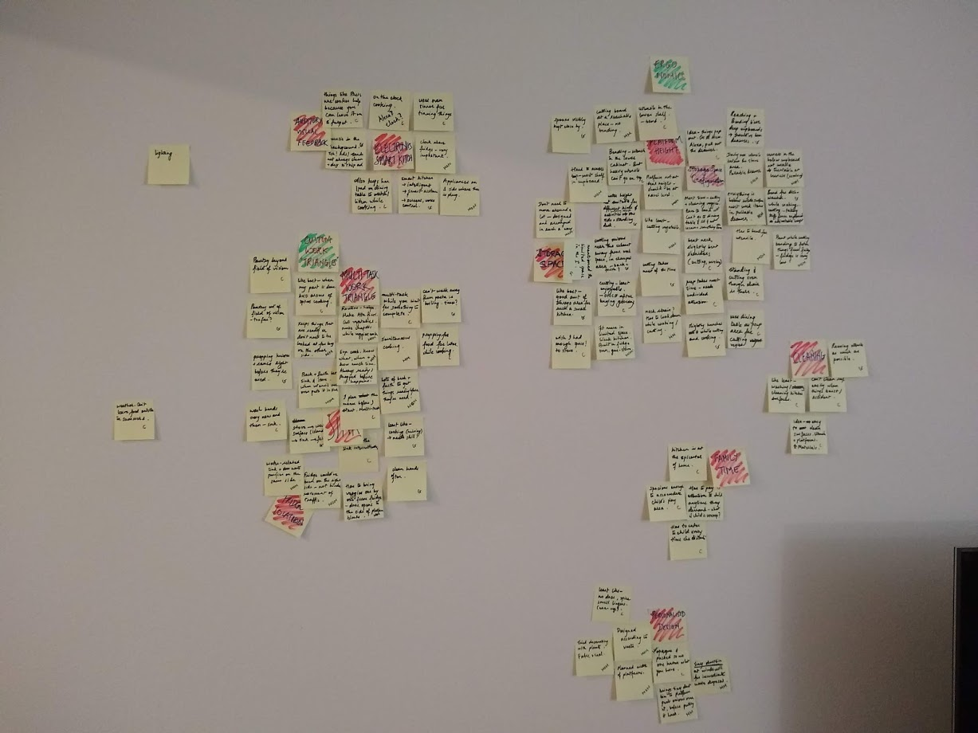
Affinity Diagram
ERGONOMICS (Platform Height, Storage space, configuration)
CUSTOM WORK “TRIANGLES” (Multi-Task, Fridge Location, Sink)
ELETRONICS / SMART KITCHEN / AUDIO VISUAL FEEDBACK
FAMILY TIME
PERSONALISED DESIGN
CLEANING, LIGHTING, WEATHER

Slide 14




Journey Map
Plan
Prep
Cook
Season
Clean
Done

Slide 15



Personas
Name: Susan
Age: 55
Prof: Government worker
Also, mom,
Also, Primary cook in the family
Experience Level: High
Wants: A kitchen that ages with her.
“I cook for multiple people multiple times a day and go to work.”
Name: Alice
Age: 35
Prof: Home-maker
Also, young mom of 4yr old
Also, Primary cook in the family
Experience Level: Medium
Wants: A kitchen that accommodates her family
“Kitchen is the epicenter of my family, we cook here, eat here, chat here and my child plays here”
Name: Bob
Age: 29
Prof: Engineer
Also, newly-wed husband,
Also, secondary cook in the family
Experience Level: Low
Wants: A kitchen that adjusts itself according to his height, and easy to use, like an app.
“I wish the kitchen island was like the desk at work, you can adjust it’s height you know? And - to be honest – cooking really isn’t my forte.”

Slide 16

Problem Statement
The problem is that even though there’s been extensive research done about Ergonomics in the kitchen, the shapes and sizes of kitchen items are still measured based on the “average”d physical characteristics of humans – thus not being a custom fit to anyone, especially considering that a kitchen is mostly used by the entire family and should be able to adapt to everyone. There are classic notions of “work triangles” that are challenged by the unique personality and belief system of each person, and do not justify the construction of their ideal kitchen.
It affects everyone who must use a kitchen, which is an essential and sometimes the most important room in a home.
and the impact is strain on some or the other body part and declining enthusiasm towards cooking
A solution would provide a kit that would allow a family to design their own kitchen by specifying the size, layout and arrangement of every item visible in the kitchen from a bird’s eye view and construct any innovative idea they can think of with the layout.

Slide 17

Ideation
Sketching + Storyboard = Design Choice

Slide 18
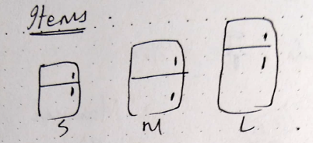
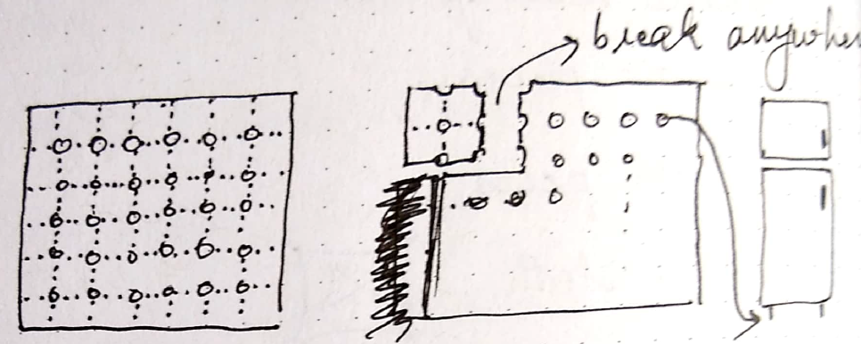
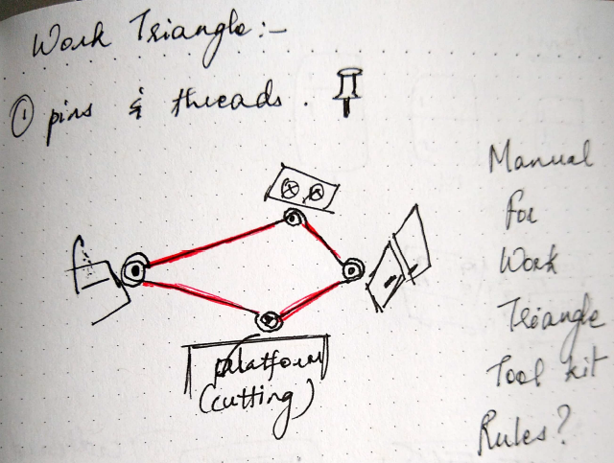
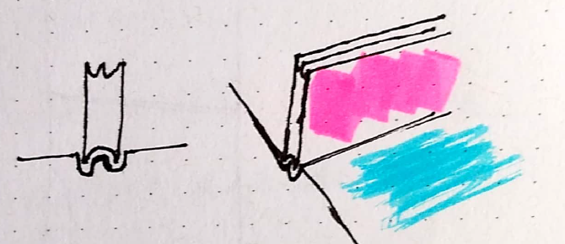
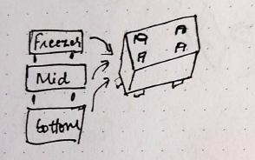
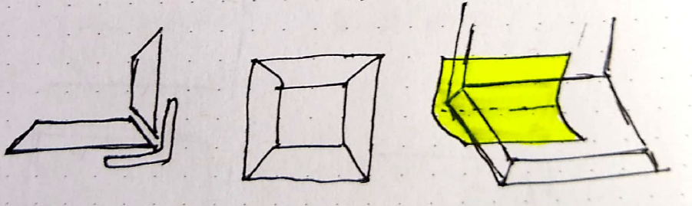
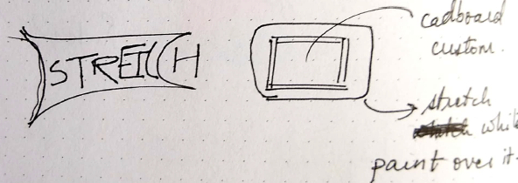
Brainstorming
Cardboards + pens + scissors/cutters
Magnetic blocks!!

Slide 19
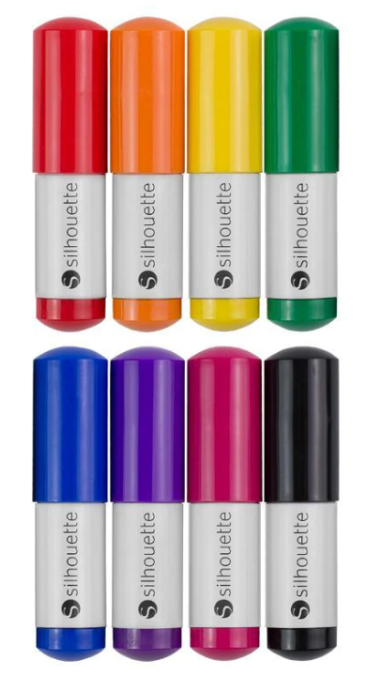
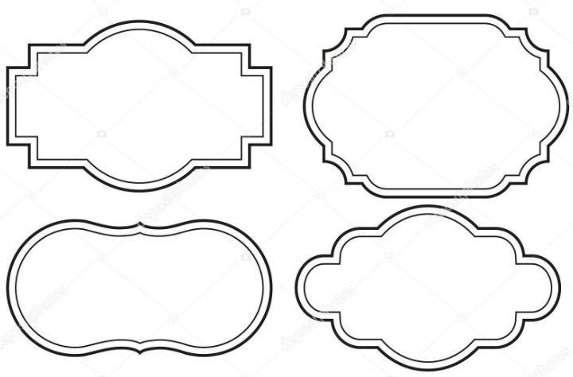
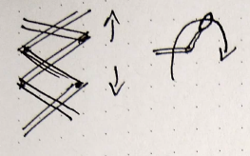
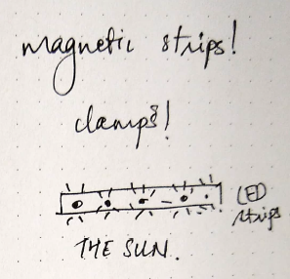
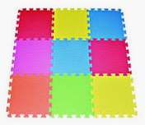


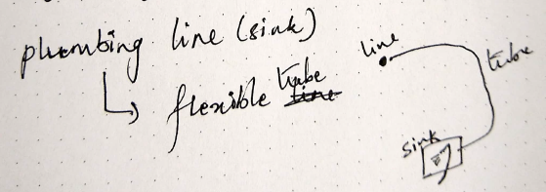


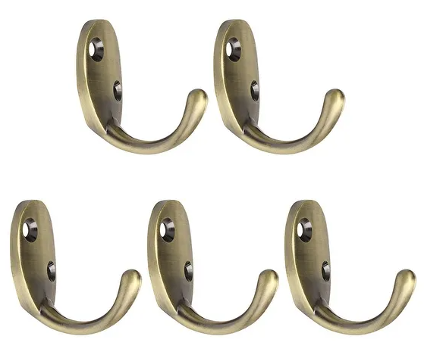
Tools
Specify plumbing line spot on the floor
Plug point position
Smart Kit:
Alexa
Mic
Screen
projector
Fridge
Microwave oven
Conventional oven
exhaust
Sink
Dining set
Sofa
Child’s play area
Tiny untensils?
Shelves/divisions

Slide 20
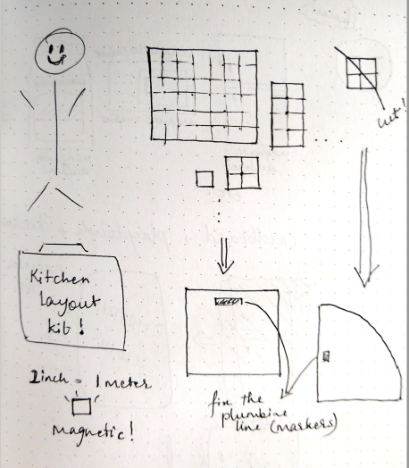
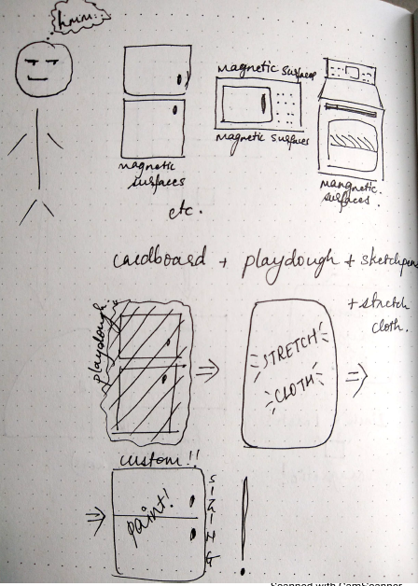
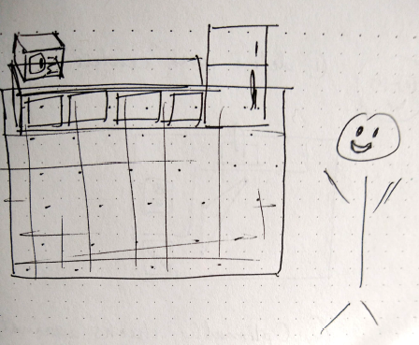
Design Choice - storyboard
Create the Floor Plan
Create the items on top of floor
Arrange on the floor

Slide 21
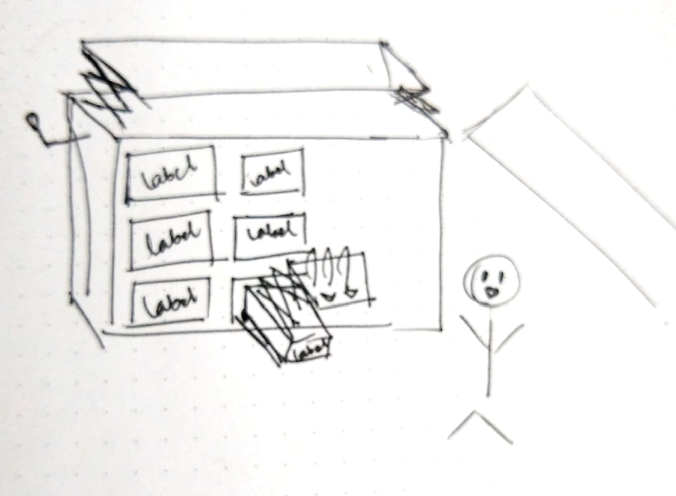
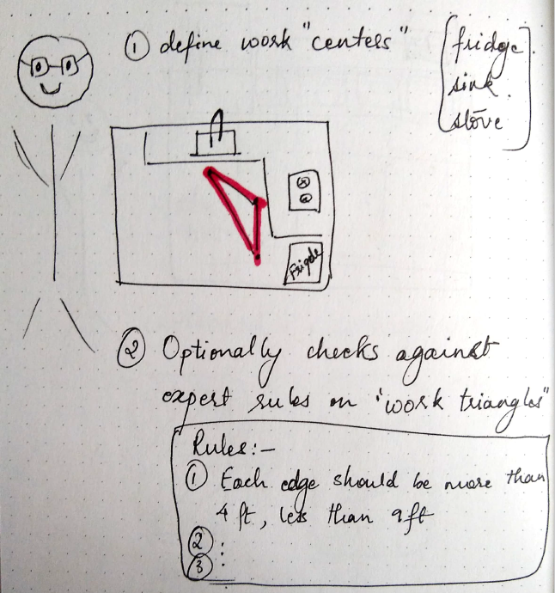
Innovate!
Test against Expert rules on “work centers”

Slide 22
Thank you! Questions?

